Slide 1
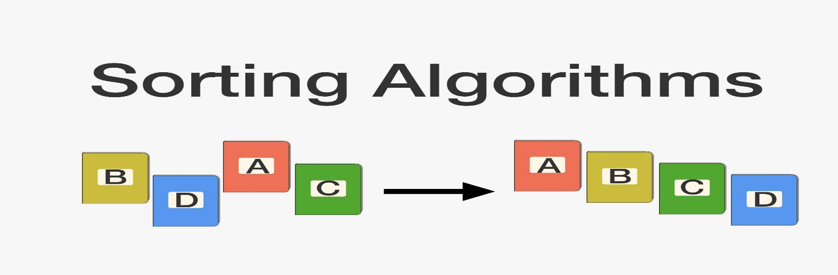
CSE214: Algorithms
Divide and Conquer Approach
and
Quick Sort
‹#›
Notes:
‹#›

Slide 2
Today’s Contents
Quick Sort
Complexity Analysis
Questions for You!
‹#›
Notes:
‹#›

Slide 3
Divide & Conquer Approach
The divide-and-conquer paradigm involves three steps at each level of the recursion:
Divide the problem into a number of subproblems.
Conquer the subproblems by solving them recursively. If the subproblem sizes are small enough, however, just solve the subproblems in a straightforward manner.
Combine the solutions to the subproblems into the solution for the original problem.
‹#›
Notes:
‹#›

Slide 4
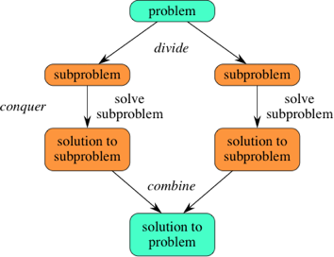
Divide & Conquer Approach
‹#›
Notes:
‹#›

Slide 5
Quick Sort
The Quick sort algorithm closely follows the divide-and-conquer paradigm.
Divide:
Partition the array A into 2 subarrays A[p..q-1] and A[q+1..r], such that each element of A[p..q-1] is smaller than or equal to each element in A[q+1..r]
Conquer:
Recursively sort A[p..q] and A[q+1..r] using Quicksort
Combine:
Trivial: the arrays are sorted in place
No additional work is required to combine them
The entire array is now sorted
‹#›
Notes:
‹#›

Slide 6
Quick Sort
Divide
Partition the array A into 2 subarrays A[p..q-1] and A[q+1..r], such that each element of A[p..q-1] is smaller than or equal to each element in A[q+1..r]
A[p…q]
≤
A[q+1…r]
‹#›
Notes:
‹#›

Slide 7
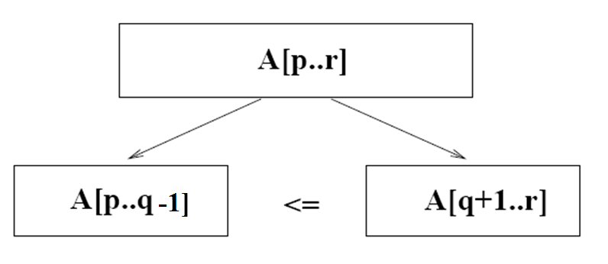
Quick Sort
Need to find index q (pivot) to partition the array
‹#›
Notes:
‹#›

Slide 8
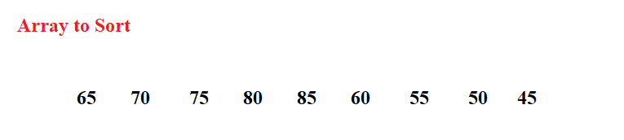
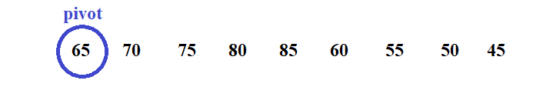
Select a Pivot to compare
j
i
i ← left
j ← right
‹#›

Slide 9
i will Search value > pivot
j will Search value <= pivot
i
i
j
‹#›

Slide 10


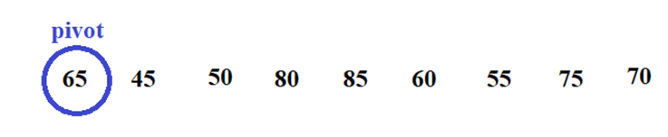
i will Search value > pivot
j will Search value <= pivot
i
i
j
i
i
i
j
j
i
j
‹#›

Slide 11
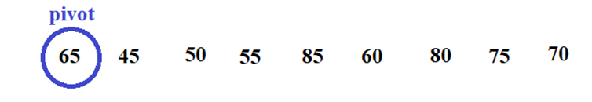
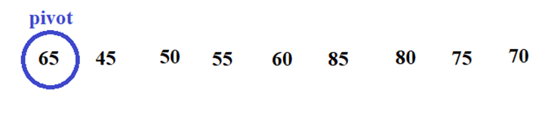
i will Search value > pivot
j will Search value <= pivot
i
i
j
j
i
i
j
j
i
j
‹#›

Slide 12
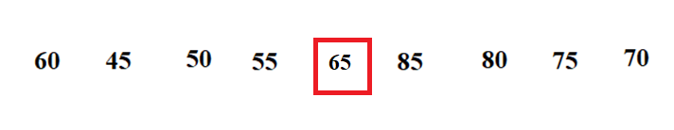
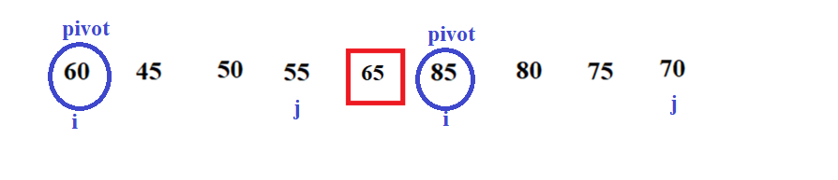
i will Search value > pivot
j will Search value <= pivot
j
i
j
i
‹#›

Slide 13
Algorithm of Quick Sort
QUICKSORT (A, left, right)
if (left < right)
q = PARTITION(A, left, right)
QUICKSORT (A, left, q-1)
QUICKSORT (A, q+1, right)
PARTITION (A, left, right)
pivot ← A[left]
i ← left
j ← right
while (i < j)
while ( A[i] < = pivot && i <= right)
i = i+1
while ( A[j] > pivot )
j = j – 1
if ( i < j )
A[i] ↔ A[j]
A[j] ↔ pivot
return j
left
right
A:
5
3
2
6
4
1
3
7
i
j
‹#›
Notes:
‹#›

Slide 14
Time Complexity
Best Case Partitioning
Partitioning (q) produces two regions of size n/2
Worst Case Partitioning
One region has one element and the other has n – 2 elements
Notes:
‹#›

Slide 15
Time Complexity
Best-case partitioning
Partitioning (q) produces two regions of size n/2
QUICKSORT (A, left, right)
if (left < right)
q = PARTITION(A, left, right)
QUICKSORT (A, left, q-1)
QUICKSORT (A, q+1, right)
O(n)
T(n/2)
T(n/2)
Complexity:
T(n) = O(n) * [T(n/2) + T(n/2)]
= O(n) * 2T(n/2)
= O(n) * O(lgn)
= O(nlgn)
‹#›
Notes:
‹#›

Slide 16
Time Complexity
Worst-case partitioning
One region has 1 element and the other has n – 1 elements
QUICKSORT (A, left, right)
if (left < right)
q = PARTITION(A, left, right)
QUICKSORT (A, left, q-1)
QUICKSORT (A, q+1, right)
O(n)
T(1)
T(n-2)
Complexity:
T(n) = O(n) * [T(1) + T(n-2)]
= O(n) * [1+ O(n)]
= O(n) * O(n)
= O(n²)
‹#›
Notes:
‹#›

Slide 17
Complexity Analysis of Three Algorithms
Algorithm | Best case | Worst case
Selection Sort | O(n²) | O(n²)
Insertion Sort | O(n) | O(n²)
Merge Sort | O(nlogn) | O(nlogn)
Quick Sort | O(nlogn) | O(n²)
‹#›
Notes:
‹#›

Slide 18
Advantage and Drawbacks
Advantages
The quick sort is regarded as the best sorting algorithm.
This is because of its significant advantage in terms of efficiency because it is able to deal well with a huge list of items.
It sorts in place, no additional storage is required as well.
Disadvantage
The slight disadvantage of quick sort is that its worst-case performance is similar to average performances of the bubble, insertion or selections sorts.
In general, the quick sort produces the most effective and widely used method of sorting a list of any item size.
‹#›
Notes:
‹#›

Slide 19
Question for you
Which Algorithm will you choose?
- For Sorted Data List
- For Unsorted Data List
2. Is Quick sort a In-Place Algorithm?
3. Sort the given data set using both the Quick Sort. Show each steps.
15 | 8 | 13 | 18 | 15 | 14
‹#›
Notes:
‹#›

Slide 20
Some References
https://visualgo.net/en/sorting
‹#›
Notes:
‹#›

Slide 21

Thank you!
‹#›

